Slide 1
Secure data hiding in images using steganography
CAPSTONE PROJECT
Presented By:
Student Name : Sandeepani Allimalla
College Name & Department : Nizam college , MCA

Slide 2
OUTLINE
Problem Statement
Technology used
Wow factors
End users
Result
Conclusion
Git-hub Link
Future scope

Slide 3
Problem Statement
In today's digital age, the need for secure communication has become increasingly vital due to the rising threats of data breaches and cyber-attacks. Traditional encryption methods, while effective, often draw attention to the presence of sensitive information, making them vulnerable to interception.
Steganography offers a solution by embedding secret data within seemingly harmless images, making the hidden information less detectable. However, many existing techniques face challenges related to maintaining image quality and ensuring that the hidden data remains secure from advanced detection tools.
This project aims to develop a robust and secure steganography method for hiding data in images without compromising image quality. The focus will be on enhancing security, minimizing the chances of detection, and ensuring that the hidden information remains intact during transmission.

Slide 4
Technology used
Operating System : Windows 10/11
Programming Language : Python
Libraries : Opencv2, OS, String
Development Software : Python 3.13.2 version
IDE : Python IDLE

Slide 5
Wow factors
Invisible Data Transmission
Advanced Encryption Integration
High Image Quality Preservation
Robust Against Steganalysis Attacks
Real-Time Data Hiding and Extraction
Multi-Format Support
User-Friendly Interface

Slide 6
End users
Government Agencies
Military Organizations
Financial Institutions
Corporate Enterprises
Journalists and Activists
Cybersecurity Firms
Healthcare Providers

Slide 7
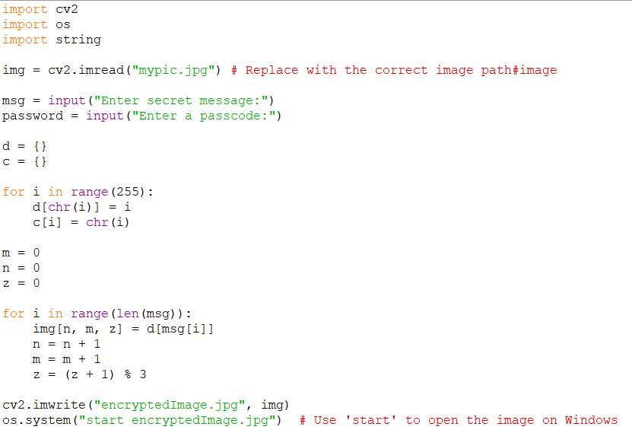
Results
Encryption source code

Slide 8
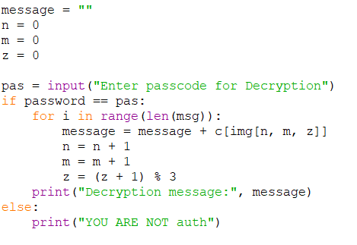
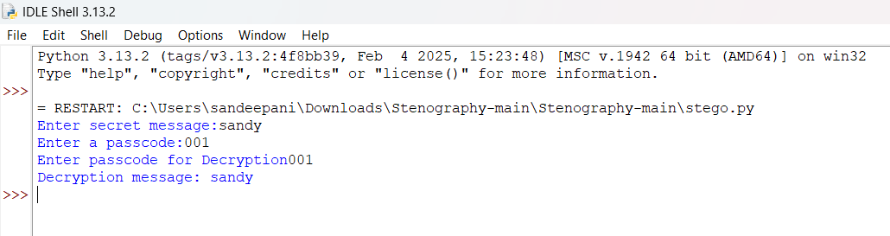
results
Decryption source code
Output

Slide 9
Conclusion
In conclusion, this project demonstrates the effectiveness of steganography as a powerful tool for secure data transmission. By embedding sensitive information within digital images, this method ensures confidentiality while maintaining the visual integrity of the cover image.
The integration of advanced security techniques enhances resistance against detection and unauthorized access. This innovative approach has vast potential across various sectors, including government, finance, healthcare, and cybersecurity. Moving forward, this project lays the groundwork for future research and development, aiming to refine data security measures and address emerging digital threats in an increasingly connected world.

Slide 10
GitHub Link
Access the Project Code on GitHub for a deeper understanding of the implementation and to explore the complete source code, visit the project's GitHub repository. This repository contains all the essential files, including code, documentation, and usage instructions. It serves as a valuable resource for developers, researchers, and anyone interested in exploring secure data hiding techniques using steganography.
https://github.com/Sandeepani29/Secure-Data-Hiding-in-Image-Using-Steganography.git

Slide 11
The future scope of this project is vast, with significant potential for advancements in secure communication and data protection. Future research can focus on integrating artificial intelligence and machine learning to enhance data embedding and detection resistance.
Additionally, expanding the technique to support multimedia formats like audio and video can broaden its applications. There is also potential for developing real-time steganography systems for secure communication in defense, financial transactions, and telemedicine. As cyber threats continue to evolve, this project can pave the way for more sophisticated, adaptive security solutions that ensure data privacy in an increasingly digital world.
Future scope

Slide 12
THANK YOU

